Slide 1
Chapter 3
Data Link Layer –Part 1

Slide 2
Outcomes
Upon completion of this chapter learner will be able to
Know and understand the various services offered by data link layer
Understand the sub layers of data link layer
Know the responsibilities of LLC or DLC and MAC sub layer
Understand framing ,framing errors , types of framing and various framing approaches.

Slide 3
Data Link Layer
is second layer of OSI Layered Model.
Also known as link layer.
Is responsible for moving data (Frames) from one node to another– node-to-node communication
This direct connection could be point to point or broadcast. Systems on broadcast network are said to be on same link.

Slide 4
Data link layer is responsible for converting data stream to signals bit by bit and to send that over the underlying hardware. At the receiving end, Data link layer picks up data from hardware which are in the form of electrical signals, assembles them in a recognizable frame format, and hands over to upper layer.

Slide 5
DATA LINK LAYER FUNCTIONS (SERVICES)
Framing
Physical Addressing
Flow Control
Error Control
Access Control

Slide 6
Framing
The data link layer needs to pack bits in to frames, so that each frame is distinguishable fro another.
Our postal system practices a type of framing
The simplest act of inserting a letter into an envelop separates one piece of information from other; the envelop serves as the delimiter.

Slide 7
Physical addressing
A frame is the encapsulation of header and trailer information with the packet.
In the header the source and the destination MAC address( hardware address) are dealt
Hardware address is assumed to be unique on the link.
It is encoded into hardware at the time of manufacturing.

Slide 8
Flow Control
One of the duties of data link control sub layer
The flow control in the data link layer is end to end flow control
Stations on same link may have different speed or capacity.
Speed matching mechanism
coordinates the amount of data that can be sent before receiving device acknowledges .

Slide 9
Access control
Media access control
when host on the shared link tries to transfer the data, it has a high probability of collision.
Data-link layer provides mechanism to equip capability of accessing a shared media among multiple Systems.

Slide 10
Synchronization
When data frames are sent on the link, both machines must be synchronized in order to transfer to take place.

Slide 11
Error Control
Sometimes signals may have encountered problem in transition and the bits are flipped.
Approaches
Error correction
Error correction

Slide 12
Data link layer has two sub-layers:
Logical Link Control: It deals with protocols, flow-control, and error control.
Media Access Control: It deals with actual control of media.

Slide 13
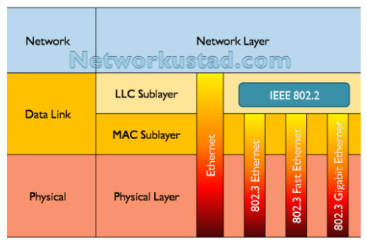
Data link sub layer

Slide 14
LLC or DLC
Handles communication between the upper layer and lower later
Takes the network protocol data and adds control information to help deliver the packet to the destination.(flow control)

Slide 15
MAC sub layer
Constitutes the lower sub layer of the data link layer.
Implemented by hardware, typically in the computer NIC
Two primary responsibilities
Data encapsulation
Media access control

Slide 16
Data encapsulation
Frame assembly before transmission and frame disassembly upon reception of a frame
MAC layer adds a header and a trailer to the network layer PDU.
Provides three primary functions
Framing
Physical addressing or MAC addressing
Error Control
Access control

Slide 17
Responsible for the placement of frames on the media and the removal of frames from the media
Directly communicate with the physical layer

Slide 18
Framing
Framing I the data link layer separates a frame distinguishable from another frame
frame=Header+ Network layer PDU + trailer.
When node A wishes to transmit a frame to node b, it tells its adapter to transmit a frame from the nodes memory
This results in a sequence of bits being sent over the link
The adapter on node B then collects together the sequence of bits arriving on the link and deposits the corresponding frame in to B’s memory.
Challenge: what set of bits constitute a frame ?

Slide 19
Types of framing
Fixed-size of the framing
Variable size framing

Slide 20
Fixed-size framing
Here the size of the frame is fixed and so the frame length acts as a delimiter of the frame
Consequently, it does not require additional boundary bits to identify the start and end of the frame.

Slide 21
Variable-size framing
Here the size of each frame to be transmitted may be different.
So additional mechanism are kept to mark the end of the frame and the beginning of the next frame and this will help us to construct the frame with out the framing error.

Slide 22
Framing approaches
Framing
Bit oriented
It simply view the frame as a collection of bits
Data is transmitted as a sequence of bits that can be interpreted in the upper layer both as a text as well as multimedia.
Bit oriented protocol
HDLC-High-Level Data link Control

Slide 23
Byte oriented
One of the oldest approach to framing
Here each frame is viewed as a collection of byte(characters) rather than bits.
a.k.a character oriented approach
Protocols
BISYNC-binary synchronous communication protocol
DDCMP– digital data communication message protocol
PPP-Point to point Protocol

Slide 24
Clock based framing
The third approach to framing is the clock based framing
Example: SONET-synchronous Optical Network

Slide 25
Flow control Protocols

Slide 26
Outcomes
Upon completion of this chapter learner will be able to
Understand flow control
Know flow control protocols.
Understand the stop-and –wait protocol
Understand the stop-and –wait protocol ARQ
Understand the sliding window protocol (Go-back-N ARQ)

Slide 27
Flow Control
Speed matching
Flow control coordinates the amount of data that can be sent before receiving an acknowledgement
Flow control is a set of procedures that tells the sender how much data it can transmit before it must wait for an acknowledgement from the receiver.
Receiver has a limited seed at which it can process incoming data and a limited amount of memory in which to store incoming data
The receiver must inform the sender before the limits are reached and request that the transmitter to send fewer frames or stop temporarily

Slide 28
Performance Metrics and Delays
Transmission time (delay)
Time taken to emit all bits into medium
Propagation time (delay)
Time for a bit to traverse the link
Processing time (delay)
time spent at the recipient or intermediate node for processing
Queuing time (delay)
waiting time at the queue to be sent out

Slide 29
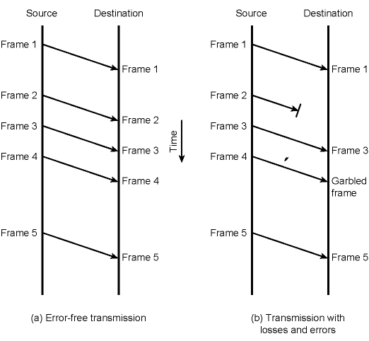
Model of Frame Transmission
propagation time
transmission time

Slide 30
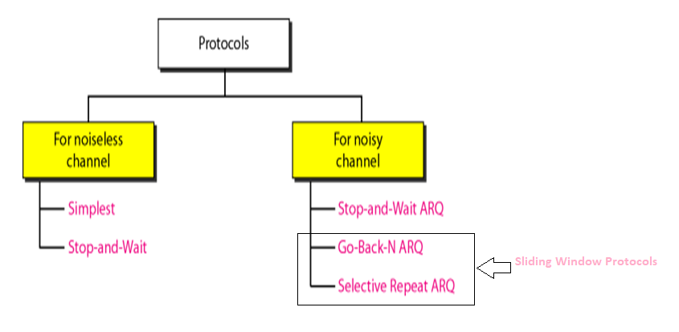

Slide 31
Stop-and- Wait Flow Control
Stop-and –wait protocol is data link layer protocol for transmission of frames over noiseless channels
It provides unidirectional data transmission with flow control facilities but with out error control facilities
After transmitting one frame, the sender waits for an acknowledgement before transmitting the next frame.

Slide 32
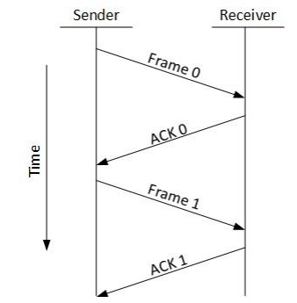
Sender side
Rule:1 Send one data packet at a time
Rule:2 Send the next packet only after receiving ACL for the previous
Receiver side
Rule:1 Receive and consume data packet
Rule:2 After consuming packet, ACK need to be sent (Flow control)

Slide 33
Problems of Stop-and-Wait Flow Control
Problems of data lost
Sender waits for ACK for an infinite amount of time
Receiver waits for an infinite amount of time for the data
Problems due to lost ACK
Sender waits for an infinite amount of time for ACK.
Problem due to delay ACK/data
After timeout on the sender side, a delayed ACK might be wrongly considered as ACK of some other data packet.

Slide 34
Stop and Wait ARQ(Automatic Repeat Request)
Idea of stop and wait protocol is straight forward
After transmitting one frame the sender waits for an acknowledgement before transmitting the next frame.
If the ACK does not arrive after a certain period of time, the sender times out and retransmits the original frame.
It is a protocol for the noisy channel
Stop-and-wait ARQ=Stop-and-Wait + Timeout Timer + Sequence number

Slide 35
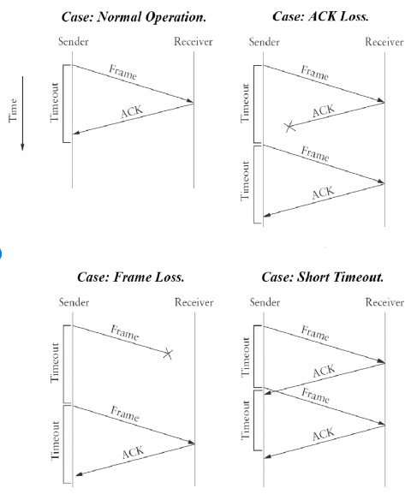

Slide 36
Stop and Wait ARQ drawback
One frame at a time
Poor utilization of bandwidth
Poor performance

Slide 37
Sliding Window protocol
Send multiple frames at a time
Number of frames to be sent is based on Window size
Each frame is numbered→ sequence number

Slide 38
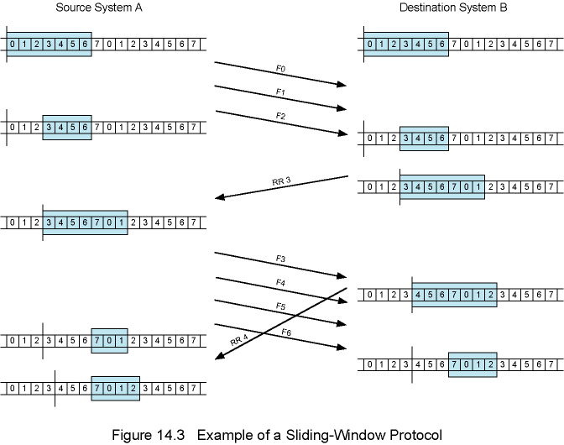
Example of a Sliding Window Protocol (W = 7)

Slide 39
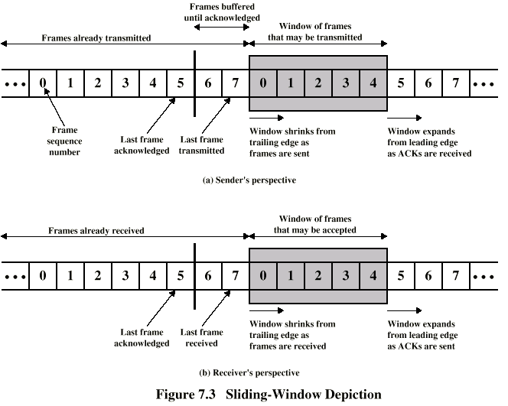
Sliding Window Flow Control (W = 7)

Slide 40
Go-Back-N ARQ
Based on sliding window
Go-Back-N ARQ uses the concept of protocol pipelining i.e. the sender can send multiple frames before receiving the acknowledgement for the first frame.
There are finite number of frames and the frames are numbered in a sequential manner.
The number of frames that can be sent depends on the window size of the sender.
N- the sender window size.

Slide 41
If the acknowledgement of a frame is not received within an agreed upon time period, all frames in the current window are transmitted.

Slide 42
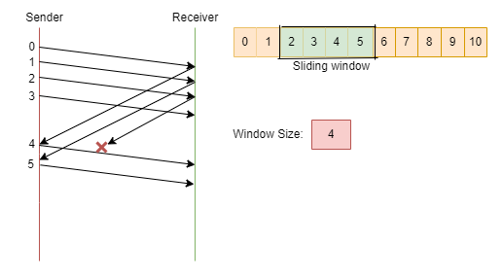
Working of Go-Back-ARQ protocol

Slide 43
Home work
1. Station A needs to send a message consisting of 9 packets to station B using a sliding window (window size 3) and go-back-n- error control strategy. All packets are ready and immediately available for transmission. If every 5th packet that A transmits gets lost (but no ACKs from B ever get lost), then what is the number of packets that A will transmit for sending the message to B?

Slide 44
2. In Go back 4, if every 6th packet that is being transmitted is lost and if total number of packets to be sent is 10, then how many transmissions will be required?

Slide 45
Selective Repeat ARQ
In selective Repeat ARQ, only the erroneous or lost frames are retransmitted, while correct frames are received and buffered.
The receiver while keeping track of sequence numbers, buffers the frames in memory and sends NACK for only frame which is missing or damaged.
The sender will send/retransmit packet for which NACK is received

Slide 46
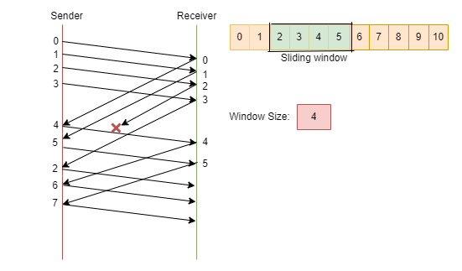

Slide 47
Minimizes retransmissions
Receiver must maintain large enough buffer
Complex implementation

Slide 48
Exercise
Ex 1. In SR protocol frames through 0 to 4 have been transmitted. Now, imagine that 0 times out, 5( a new frame) is transmitted, I times out, 2 times out and 6( another new frame) is transmitted. At this point, what will be the outstanding packets in sender’s window ?

Slide 49
Host A wants to send 10 frames to Host B. the hosts agreed to go with SR ARQ. How may number of frames are transmitted by Host A if every 6th frame that is transmitted by host A is either corrupted of lost ? Also compare the number of transmissions of SRARQ with Go-Back-$ ARQ.

Slide 50
ERROR DETECTION AND CORRECTION

Slide 51
Outcomes
Upon completion of this chapter learner will be able to
Understand transmission errors
Know the type of errors
Understand error detection and correction
Know the various error detection techniques

Slide 52
Error control
Error control mechanisms are techniques (e.g., Checksum, CRC) that enable reliable delivery of data over unreliable communication channels Error Control

Slide 53
Error
data being transmitted over the network can be corrupted during transmission.
The errors that are caused due to this transmission is known as transmission error.
for reliable communication, errors must be detected and corrected.
Error detection and correction are implemented either at the data link layer or at the transport layer of the OSI model

Slide 54
So we have to
detect errors
if possible, correct errors
adopt flow control algorithms such that erroneous frames are retransmitted

Slide 55
Types of Errors
Data-link layer uses some error control mechanism to ensure that frames (data bit streams) are transmitted with certain level of accuracy. But to understand how errors is controlled, it is essential to know what types of errors may occur.
There are three types of errors
bit error
Burst error

Slide 56
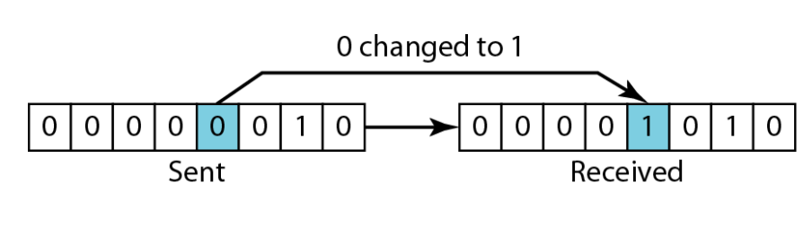
Single bit errors
a.k.a single bit error
only 1 bit in the data unit has been changed
not so common in real life

Slide 57
Burst errors
two or more bits in the data unit have changed
most common case
a burst error of length B is a contiguous sequence of B bits in which the first and the last and some intermediate bits are erroneously flipped.
not necessarily all bits between the first and the last one.

Slide 58
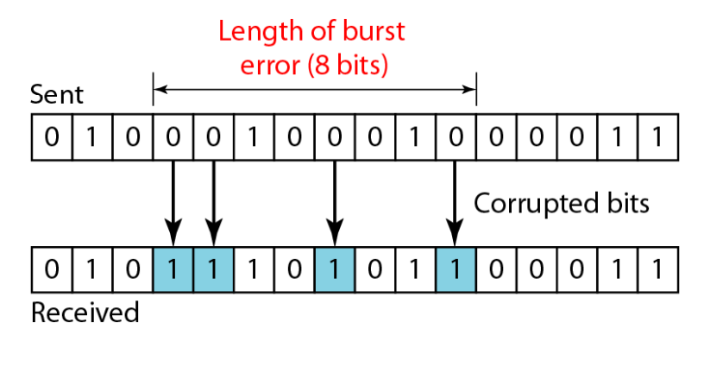

Slide 59
Error Detection and Correction
Error detection refers to a class of techniques for detecting garbled messages
Adding some Extra bits to detect Occurrence of error
Not enough to detect the position of errors
Error correction
Adding enough redundant bits to deduce what the correct bits are
Error Correction are too expensive and hard

Slide 60
How to detect the errors ?
Redundancy
Error detection means to decide whether the received data is correct or not without having a copy of the original data.
To detect or correct errors, we need to send some extra bits with the data . This extra bits are called redundant bits.
These redundant bits are added by the sender and removed by the receiver.

Slide 61
Error correction
Can be handled in two ways
Receiver can have the sender retransmit the entire data unit.
The receiver can use an error-correcting code, which automatically corrects certain errors

Slide 62
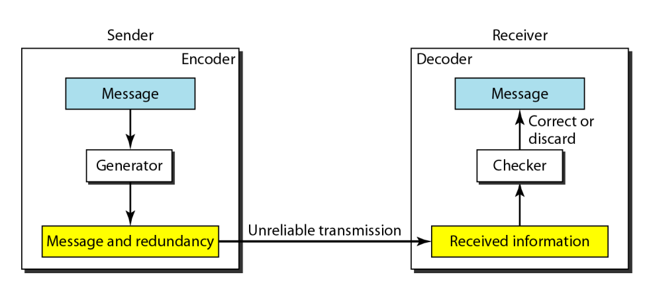
Error detection/correction

Slide 63
Error Detecting Codes techniques
Simple Parity check or Vertical redundancy check (VRC)
Two-dimensional Parity check or Longitudinal Redundancy Check(LRC)
Cyclic redundancy check (CRC)
Check Sum

Slide 64
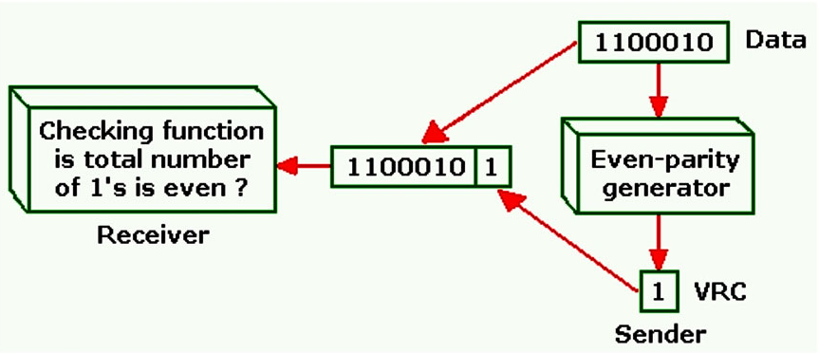
Simple Parity Checking or One-dimension Parity Check

Slide 65
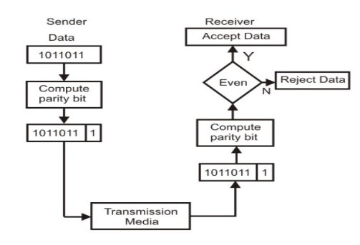
Even-parity checking scheme

Slide 66
Performance of Simple Parity Checks
can detect all single bit errors.
It can also detect burst error only if the number of bits in the error is odd.
Sender:11100001→transmission error 10100001→ Receiver rejects the data
Sender:11100001→transmission error 10100101→ Receiver accepts the data
Even number of bit errors goes undetected
thus not so useful

Slide 67
Longitudinal redundancy check(LRC)
In LRC, a block of bits is organized in to rows and columns
a.k.a Two dimensional parity
The parity bit is calculated for each column and sent along with the data
The block of parity acts as the redundant bits

Slide 68
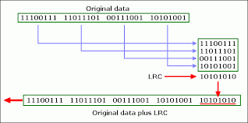
LRC-Example
Find the LRC for the data blocks 111000111 11011101 00111001 01010101
Odd no. 1s | 1
Even no. 1 s | 0

Slide 69
Two Dimensional Parity Check ...Performance
improves error detection capability compared to simple parity check .
Increases the likelihood of detecting burst errors.
It can detect many burst errors, but not all.

Slide 70
There is, however, one pattern of error that remains elusive. If two bits in one data unit are damaged and two bits in exactly same position in another data unit are also damaged, the LRC checker will not detect an error. Example, if two data units: 11001100 and 10101100. If first and second from last bits in each of them is changed, making the data units as 01001110 and 00101110, the error cannot be detected by LRC Parity check.

Slide 71
Home work
Find the LRC for the data blocks 01110111 10101001 01101001 10101010 and determine the data that is transmitted ?

Slide 72
Checksum
Checksum=Check+sum
Sender side→ Check sum creation
Receiver side→ Check sum validation

Slide 73
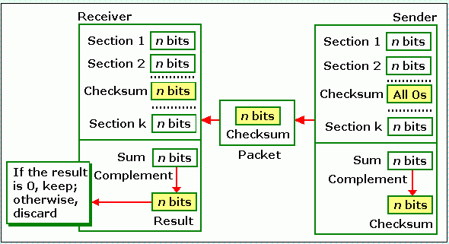
Checksum-operation at the sender side
The sender's end:
break the original message into ‘k’ number of blocks with ‘n’ bits in each block.
Sum all the ‘k’ data blocks.
Add the carry to the sum if any.
Do the 1’s complement to the sum= checksum
The checksum segment is sent along with the data segments.

Slide 74
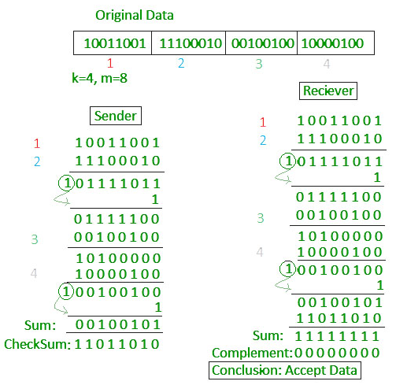
Checksum-example
Consider the data unit to be transmitted is 10011001111000100010010010000100

Slide 75
Collect all the data blocks including the checksum
Sum the data blocks and checksum
If the result is all 1’s, accept; else, reject

Slide 76
Performance of Checksum
Less overhead than two dimensional
The checksum detects all errors involving an odd number of bits.
At also detects most errors involving even number of bits.
If one or more bits of a segment are damaged and the corresponding bit or bits of opposite value in a second segment are also damaged, the sum of those columns will not change and the receiver will not detect the error(S)

Slide 77
Cyclic Redundancy Check (CRC)
One of the most powerful and commonly used error detecting codes.
Find the CRC for the data blocks 100100 with the divisor 1101 ?

Slide 78
CRC generation at the sender side
1. find the length of the divisor ‘L’
2. Append “L-1” bits to the original message
3. Perform binary division operation
4. Reminder of the division →CRC

Slide 79
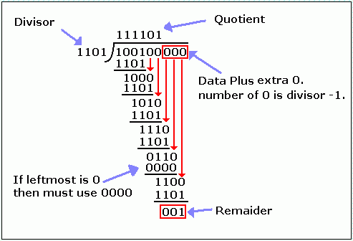
Sender side ?
Data Transmitted: 100100001

Slide 80
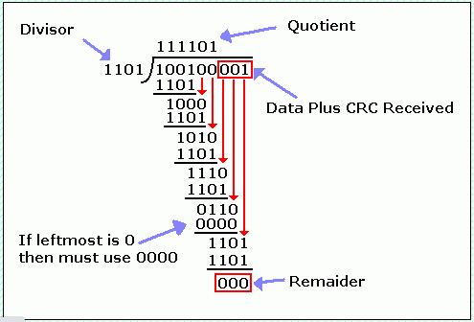
CRC-at the receiver side

Slide 81
Exercise
Find the CRC for 1110010101 with the divisor x³+x²+1 ?
2. suppose we want to transmit the message 11001001 and protect it from errors using the CRC polynomial x3+1 use polynomial long division to determine the message that should be transmitted. Corrupt the left-most third bit of the transmitted message and show that the error is created by the receiver using CRC technique

Slide 82
Performance
CRC can detect all single-bit errors
CRC can detect all double-bit errors (three l's)
CRC can detect any odd number of errors (X+1)
CRC can detect all burst errors of less than the degree of the polynomial.
CRC detects most of the larger burst errors with a high probability. .For example CRC-12 detects 99.97% of errors with a length 12 or more.

Slide 83
Error Correction
Actions to be taken against
Lost frames
Damaged frames
Error Correction codes are used to detect and repair mistakes that occur during data transmission from the transmitter to the receiver.
Two Basic Approaches:
Backward error correction: When an error is detected in a frame, the sender is asked to retransmit the data/frame. This approach is known as Automatic Repeat Request (ARQ) technique.
Forward error correction: In this case, the receiver uses the error-correcting code which automatically corrects the errors.

Slide 84
A single additional bit can detect the error, but cannot correct it.
For correcting the errors, one has to know the exact position of the error. For example, If we want to calculate a single-bit error, the error correction code will determine which one of seven bits is in error. To achieve this, we have to add some additional redundant bits.

Slide 85
Suppose r is the number of redundant bits and d is the total number of the data bits. The number of redundant bits r can be calculated by using the formula: 2^{r}>=d+r+1
The value of r is calculated by using the above formula. For example, if the value of d is 4, then the possible smallest value that satisfies the above relation would be 3.
To determine the position of the bit which is in error, a technique developed by R.W Hamming is Hamming code which can be applied to any length of the data unit and uses the relationship between data units and redundant units.

Slide 86
Hamming Code
Data Bits: the data you want to transmit
Parity bits: The bit which is appended to the original data of binary bits so that the total number of 1s is even or odd.
Even parity: To check for even parity, if the total number of 1s is even, then the value of the parity bit is 0. If the total number of 1s occurrences is odd, then the value of the parity bit is 1.
Odd Parity: To check for odd parity, if the total number of 1s is even, then the value of parity bit is 1. If the total number of 1s is odd, then the value of parity bit is 0.

Slide 87
Algorithm of Hamming code
An information of 'd' bits are added to the redundant bits ‘p' to form d+p.
The location of each of the (d+p) digits is assigned a decimal value.
The ‘p’ parity bits are placed in positions 2^{n} where n=0,1, 2,….n positions. →1,2,…1,2,.....2^{r-1}.
At the receiving end, the parity bits are recalculated. The decimal value of the parity bits determines the position of an error.

Slide 88
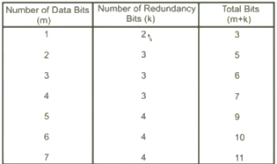

Slide 89
Let's understand the concept of Hamming code through an example:
Suppose the original data is 1010 which is to be sent.
Total number of data bits 'd' = 4
Number of redundant bits r : 2^{p} >= d+p+1
2^{p}>= 4+r+1
Therefore, the value of r is 3 that satisfies the above relation. Total number of bits = d+p = 4+3 = 7;

Slide 90
Determining the position of the redundant bits
The number of redundant bits is 3. The three bits are represented by p1, p2, p3.
The position of the redundant bits is calculated with corresponds to the raised power of 2. Therefore, their corresponding positions are 2⁰, 2¹, 2².
The position of p1 = 1
The position of p2 = 2
The position of p3 = 4
7 | 6 | 5 | 4 | 3 | 2 | 1
1 | 0 | 1 | p3 | 0 | p2 | p1

Slide 91
Determining the Parity bits
Determining the p1 bit
The p1 bit is calculated by performing a parity check on the bit positions whose binary representation includes 1 in the first position.
p1
0111 | 0110 | 0101 | 0100 | 0011 | 0010 | 0001
7 | 6 | 5 | 4 | 3 | 2 | 1
1 | 0 | 1 | p3 | 0 | p2 | p1

Slide 92
We observe from the above figure that the bit positions that includes 1 in the first position are 1, 3, 5, 7.
Now, we perform the even-parity check at these bit positions. The total number of 1 at these bit positions corresponding to p1 is even, therefore, the value of the p1 bit is 0.

Slide 93
Determining p2 bit
The p2 bit is calculated by performing a parity check on the bit positions whose binary representation includes 1 in the second position.
p2
0111 | 0110 | 0101 | 0100 | 0011 | 0010 | 0001
7 | 6 | 5 | 4 | 3 | 2 | 1
1 | 0 | 1 | p3 | 0 | p2 | p1

Slide 94
We observe from the above figure that the bit positions that includes 1 in the second position are 2, 3, 6, 7.
Now, we perform the even-parity check at these bit positions. The total number of 1 at these bit positions corresponding to p2 is odd, therefore, the value of the p2 bit is 1.

Slide 95
Determining p3 bit
The p3 bit is calculated by performing a parity check on the bit positions whose binary representation includes 1 in the third position.
p3
0111 | 0110 | 0101 | 0100 | 0011 | 0010 | 0001
7 | 6 | 5 | 4 | 3 | 2 | 1
1 | 0 | 1 | p3 | 0 | p2 | p1

Slide 96
We observe from the above figure that the bit positions that includes 1 in the third position are 4, 5, 6, 7.
Now, we perform the even-parity check at these bit positions. The total number of 1 at these bit positions corresponding to p3 is even, therefore, the value of the p3 bit is 0.

Slide 97

Data transferred is given below:
Suppose the 4th bit is changed from 0 to 1 at the receiving end, then parity bits are recalculated.

Slide 98
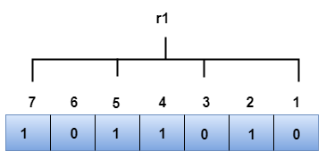
P1 bit
The bit positions of the P1 bit are 1,3,5,7
We observe from the above figure that the binary representation of r1 is 1100. Now, we perform the even-parity check, the total number of 1s appearing in the r1 bit is an even number. Therefore, the value of r1 is 0.

Slide 99
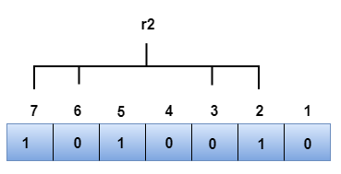
P2 bit
The bit positions of P2 bit are 2,3,6,7.
We observe from the above figure that the binary representation of P2 is 1001. Now, we perform the even-parity check, the total number of 1s appearing in the r2 bit is an even number. Therefore, the value of r2 is 0.

Slide 100
P3 bit
The bit positions of P3 bit are 4,5,6,7.
We observe from the above figure that the binary representation of P3 is 1011. Now, we perform the even-parity check, the total number of 1s appearing in the P4 bit is an odd number. Therefore, the value of P4 is 1.
The binary representation of redundant bits, i.e., P3P2P1 is 100, and its corresponding decimal value is 4. Therefore, the error occurs in a 4th bit position. The bit value must be changed from 1 to 0 to correct the error.

Slide 101
Backward Error ontrol
Model of frame transmission
Data are sent as a sequence of frames.
Frames arrive at the same order as they are sent.
Each transmitted frame suffers an arbitrary and variable amount of delay before reception.
In addition to above, following two types of errors may occur:
Lost frame: A frame fails to arrive at the other side.
A noise burst may damage a frame to such an extent that it is not recognizable at the receiving end
Damaged frame: A recognizable frame does arrive, but some of the bits are In error.

Slide 102
Backward Error Control
Most common techniques for error control are based on some or all of the following:
Error detection: We have already discussed.
Positive acknowledgement: The destination returns a positive acknowledgement to successfully received errorfree frames.
- Retransmission after timeout: The source retransmits a frame that has not been acknowledged after a predetermined amount of time.
- Negative acknowledgement and retransmission: The destination returns a negative acknowledgement to frames in which an error is detected. The source retransmits such frames.

Slide 103
Error Control Techniques Collectively, the mechanisms are referred to as Automatic Repeat Request (ARQ).
Objective is to turn an unreliable data link into a reliable one.
Three versions of ARQ are:
Stop-and-wait
Go-back-N Selective-repeat
Selective-reject (selective retransmission) ARQ

